Slide 1
Progress Meeting
2017/7/26

Slide 2
Agenda
Spectral Graph for node embeddings
Approximation theory and spectral graph theory
Chebyshev approximation and experiments
Chevyshev fundamentals(link)
Chevyshev implementation (GCN v.s. GCN_cheby)
Parameters study by experiments
Other option: Lancsoz methods

Slide 3
Chebyshev methods
The discussion here will mainly focus on two recent papers:
Defferrard et al. (NIPS 2016), Convolutional Neural Networks on Graphs with Fast Localized Spectral Filtering
Contribution: First introduced Spectral Graph theory and Chebyshev approximation by CNN, GCN_cheby
10k nodes will burst the memory
Kipf & Welling (ICLR 2017), Semi-Supervised Classification with Graph Convolutional Networks
Contribution: Effectiveness and Efficiency Improvement GCN
Experimental results recap:
random walk + word2vec v.s. spectral graph (always better)
GCN(always better) v.s. GCN_cheby (slow, and often crashes)

Slide 4
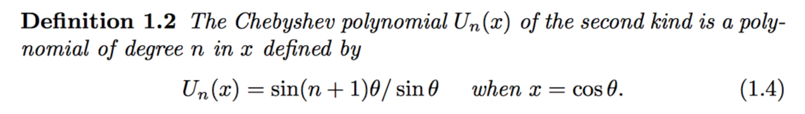

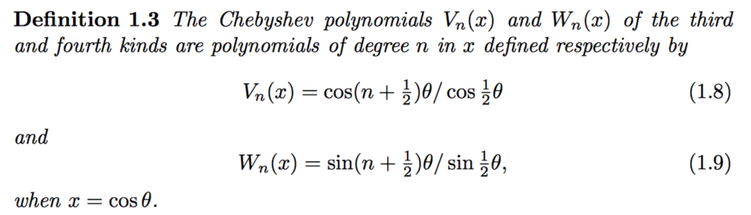
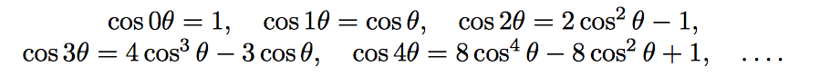


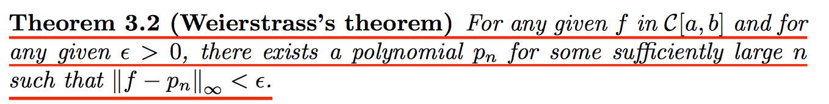
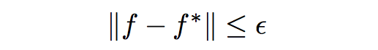


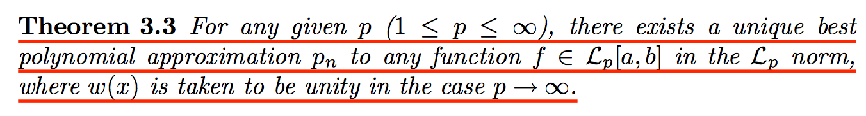
What is Chebyshev Poly.
Application: minimax approximation of functions by polynomials.
Good
Best
Near-Best

Slide 5
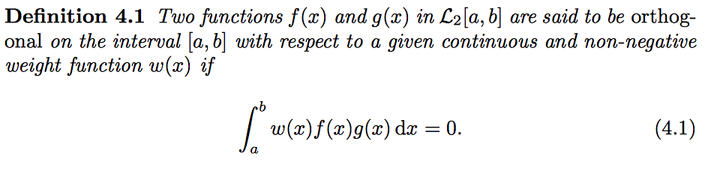

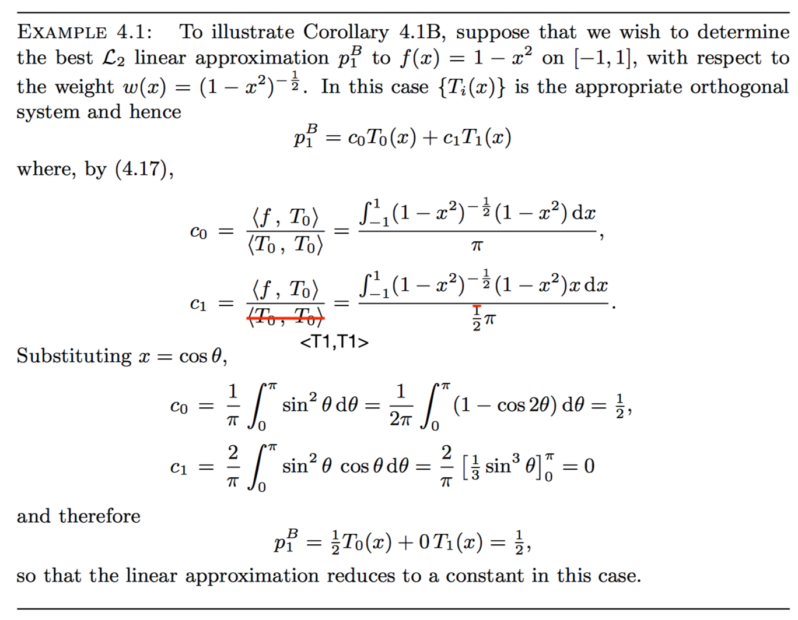

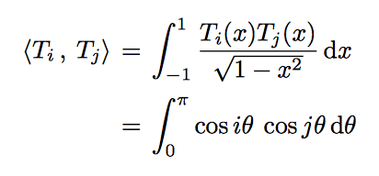
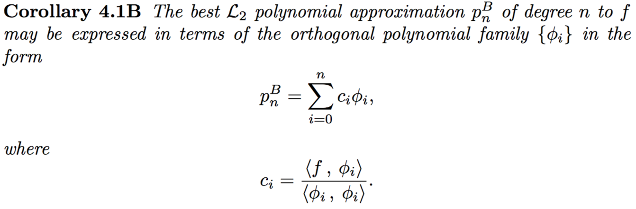
How to use Chebyshev Poly.
Orthogonality(think about Fourier series)
Example
For the 1st kind of Chebyshev Ploy.
Best approx. property

Slide 6
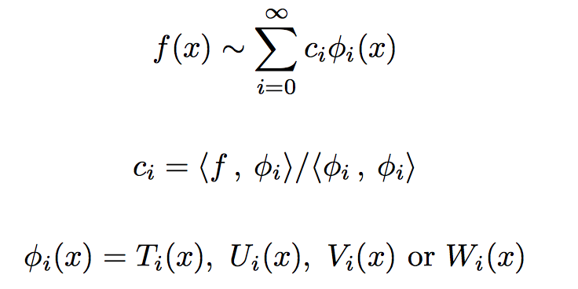
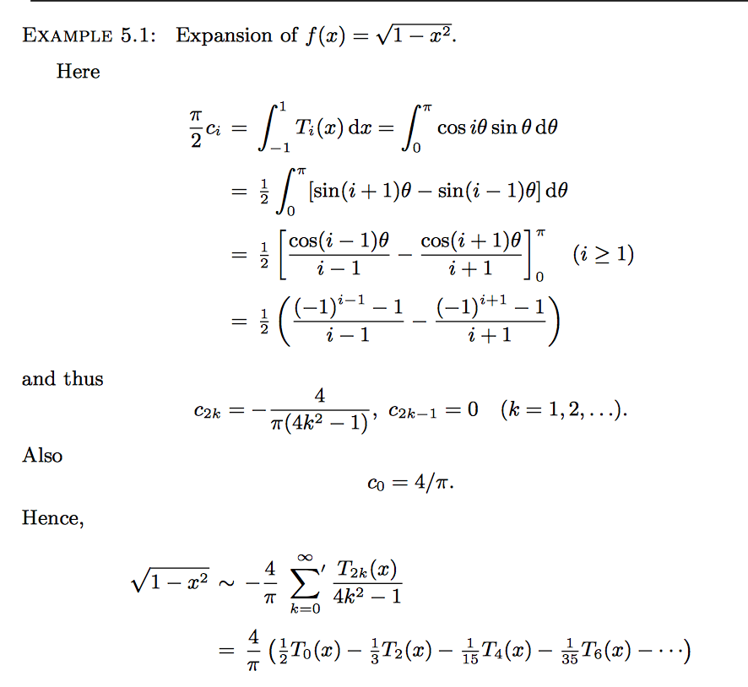
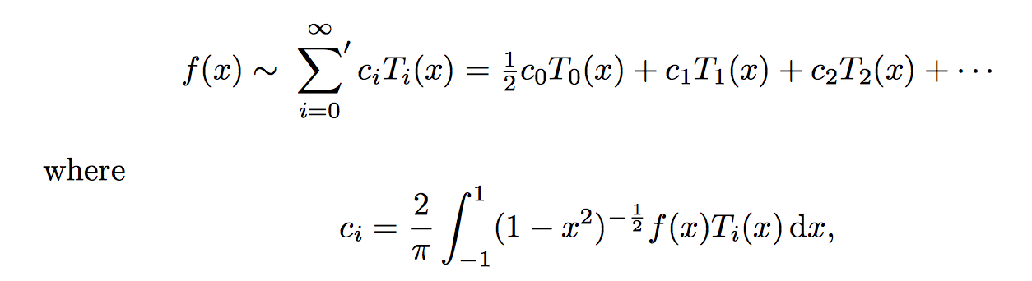
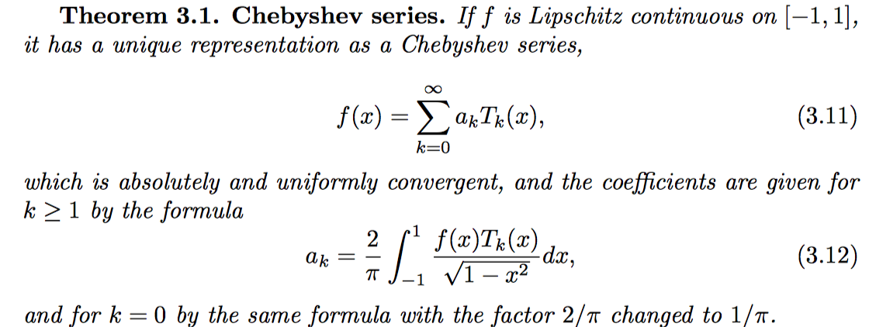
How to use Chebyshev Poly.
Best approx. of Chebyshev Poly.
Example
Error bound

Slide 7
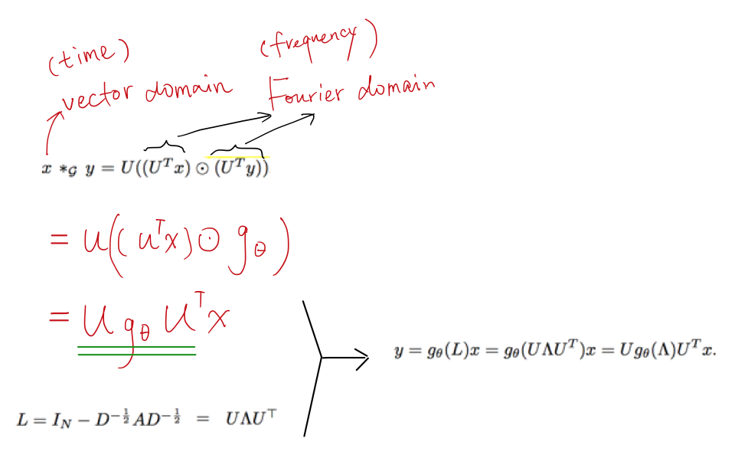
Chebyshev methods
Defferrard et al. (NIPS 2016), Convolutional Neural Networks on Graphs with Fast Localized Spectral Filtering, GCN_cheby
INPUT: x: raw nodes features; L: graph Laplacian
OUTPUT: embeddings of x
Formula A
Formula C
Formula B

Slide 8


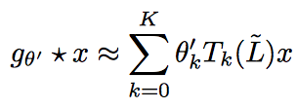
Chebyshev methods
GCN_cheby
calculate normalized graph Laplacian
calculate eigenvalues of normalized graph Laplacian (time consuming)
normalize the normalized Laplacian
apply Chebyshev polynomial
GCN
calculate normalized graph Laplacian
assume lambda_max=2, and NN will learn the scale

Slide 9
Chebyshev experiments
Performance under difference numbers of layers(GCN)
10k dp | 1k feat | 10class
20class
50class
100feat
20k dp

Slide 10
Chebyshev experiments
Performance under difference numbers of Chebyshev orders
5k dp | 0.5k feat | 10class

Slide 11
Chebyshev experiments
Performance under difference numbers of Chebyshev orders
20class
50class
100feat

Slide 12
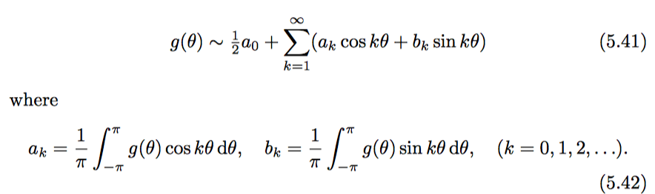
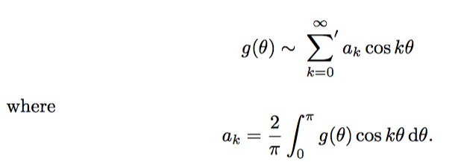
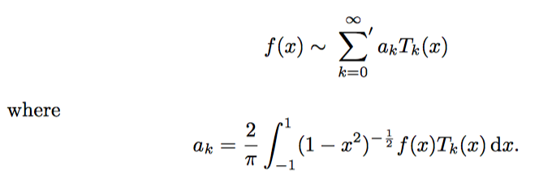
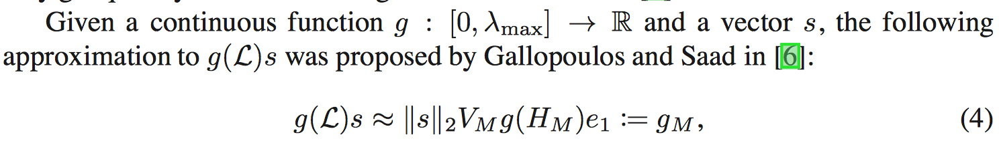
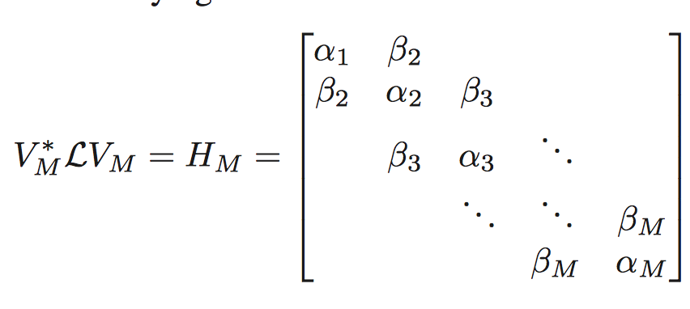


Any option for Chebyshev?
2nd, 3rd and 4th Chebyshev polynomials
Fourier series equal to Chebyshev series when g is even
Lanczos method (mentioned in GCN_cheby):
Complexity comparison with GCN: v.s.
Lanczos approximation can be expected to perform significantly better because of its ability to adapt to the eigenvalues of L. (This phenomenon is well-understood for Krylov subspace approximations to solutions of linear system.)
Susnjara, Ana, et al. "Accelerated filtering on graphs using lanczos method." arXiv preprint arXiv:1509.04537 (2015).

